Slide 1

PLAY
FFWD
RWD

Slide 2

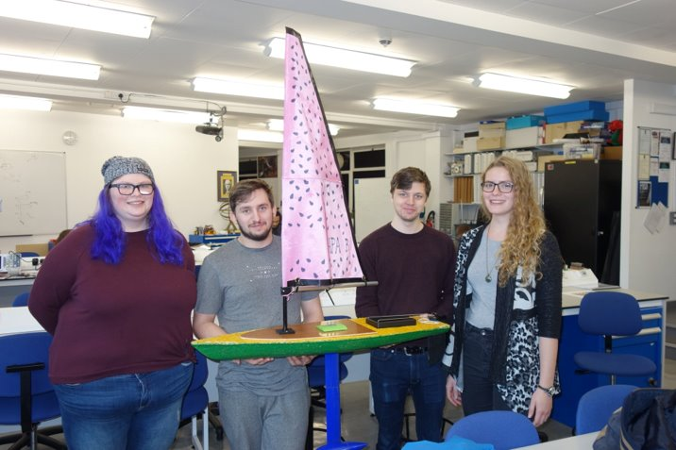

Who are we?
PLAY
A group of students building autonomous robotics sailing boats (sailbots)

Slide 3
What do we do?
01
02
Write code
Go to competitions
03
Public engagement
Surprising, innit?
Before deadly virus came to our lives and locked us to our homes.
Showing off

Slide 4
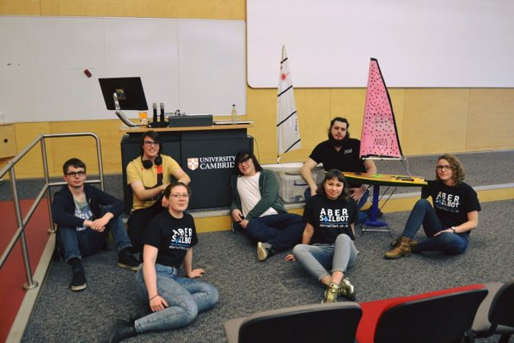

Slide 5
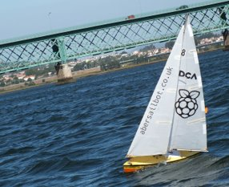
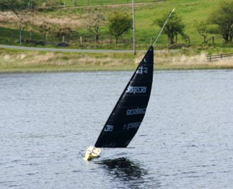
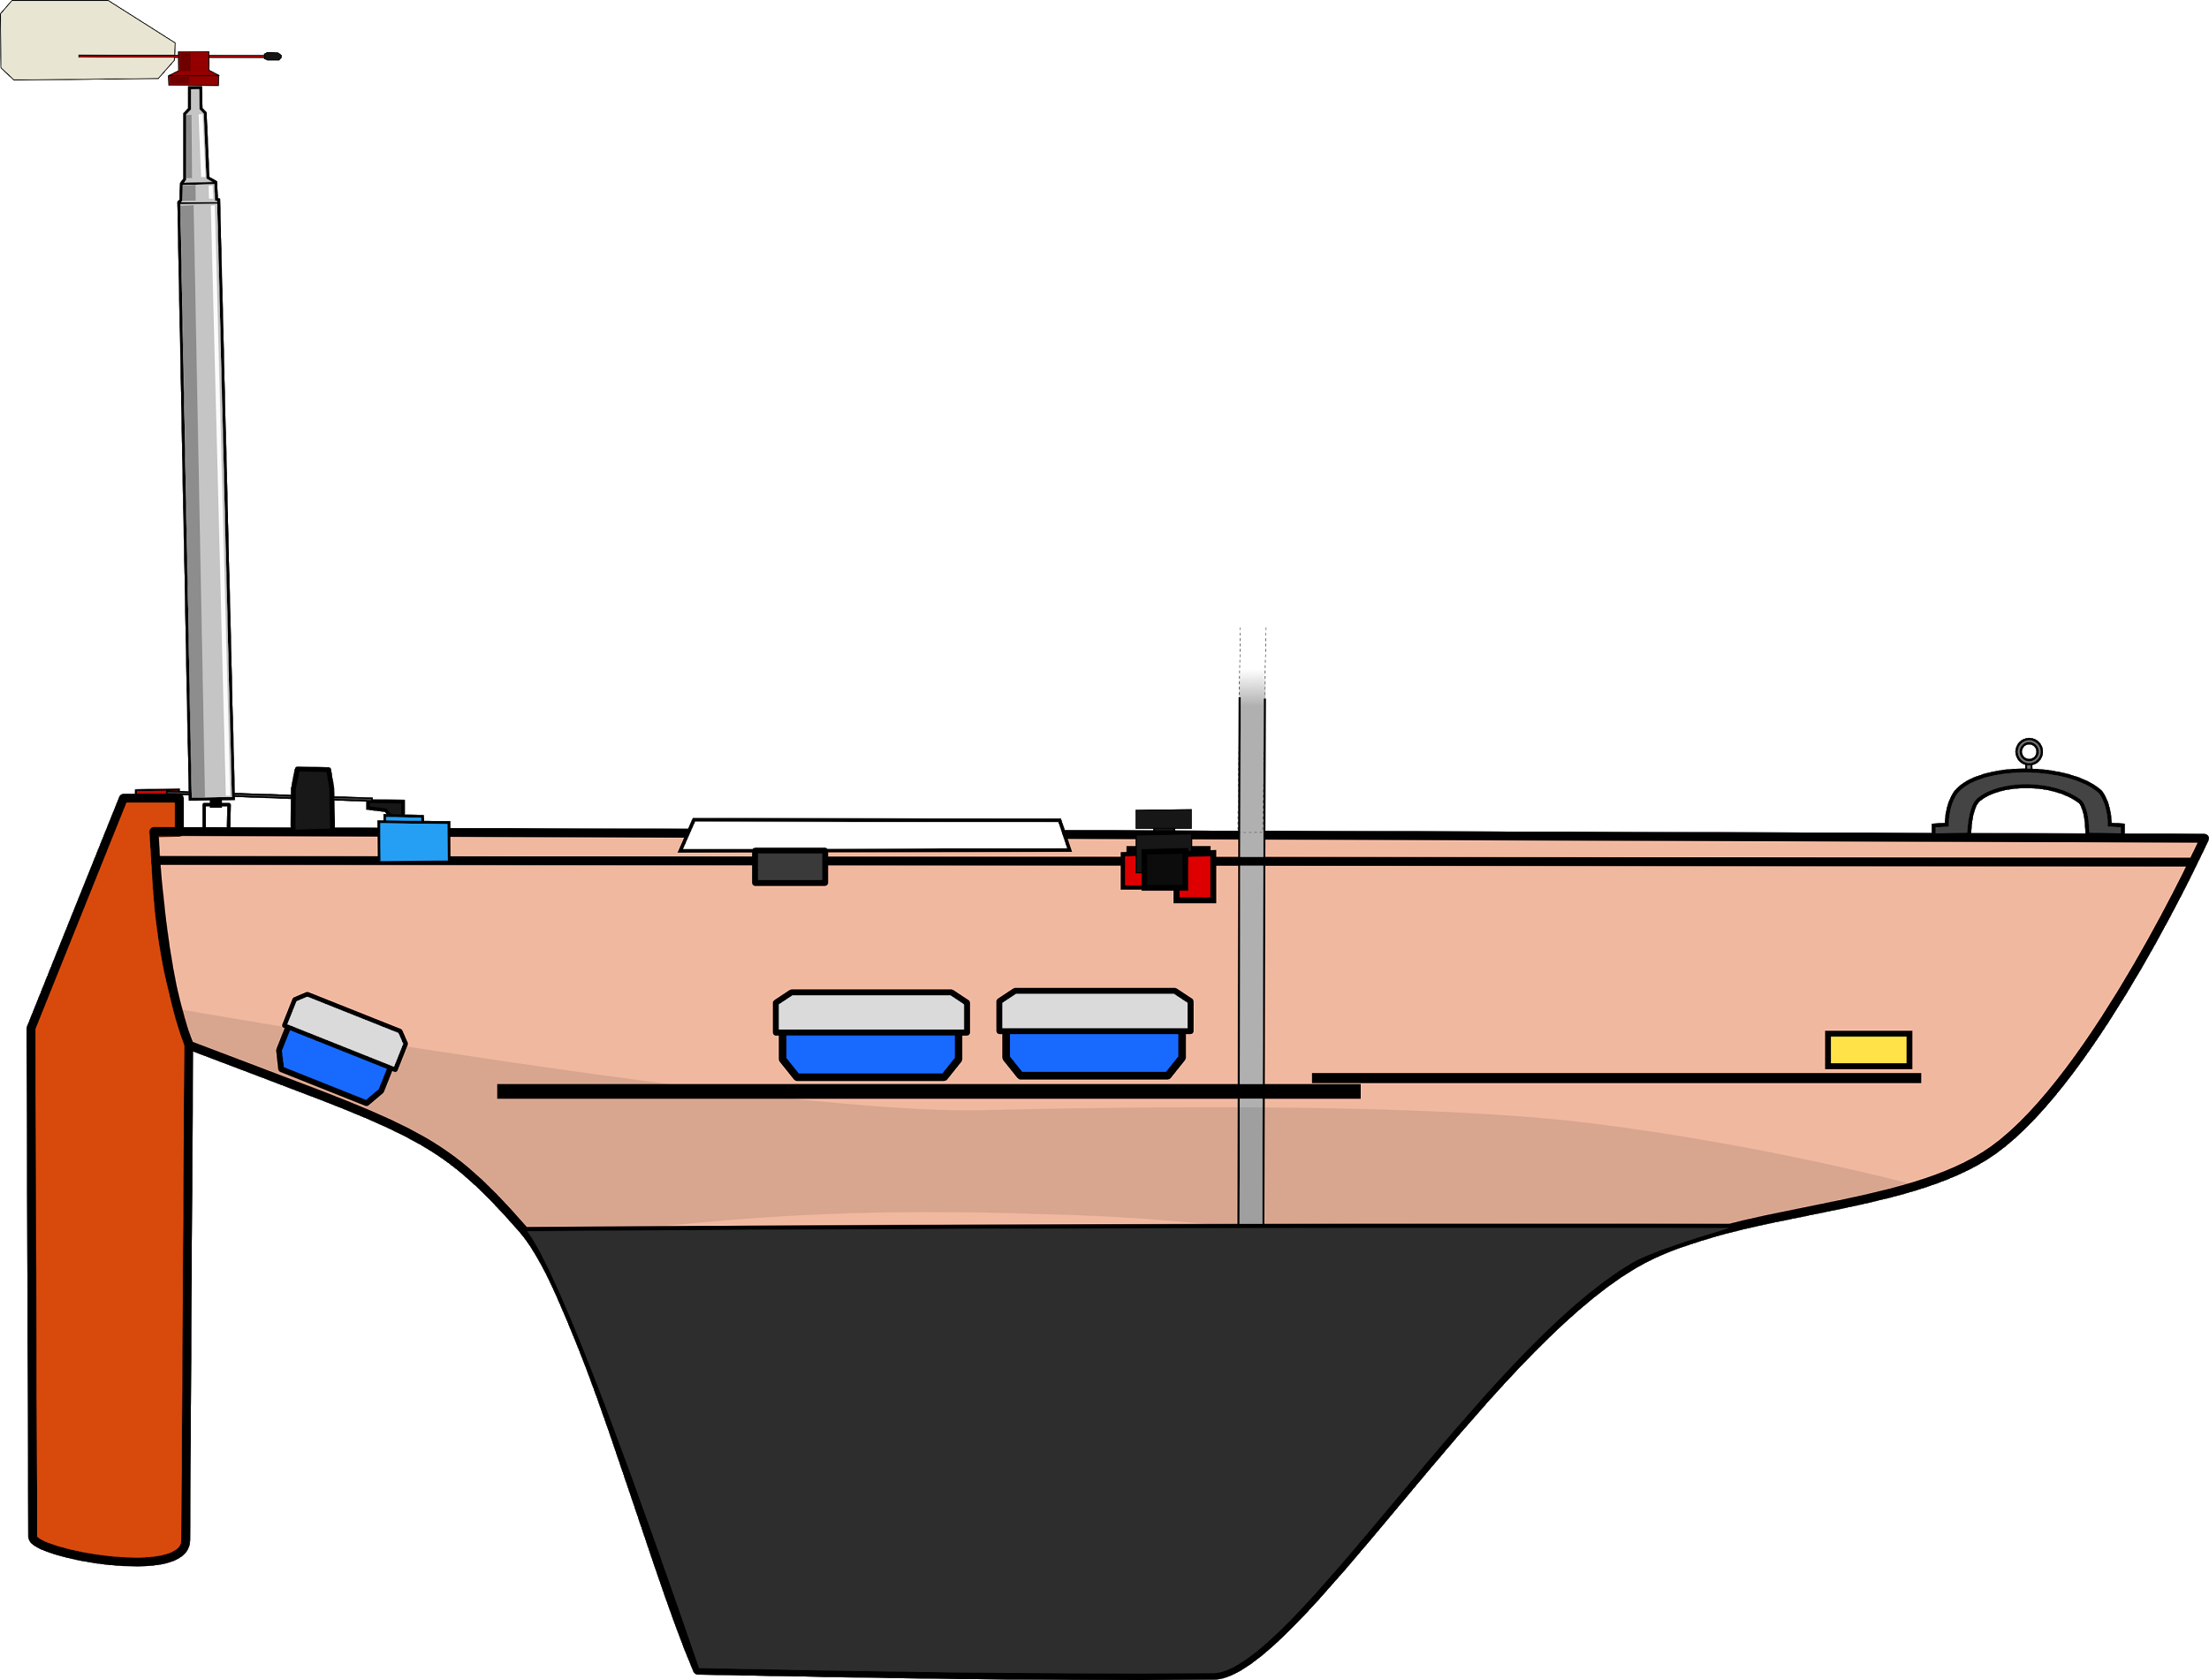
Two main boats
Dewi’r Ddraig
Kitty

Slide 6



How we work
No SU society
Discord
GitHub

Slide 7
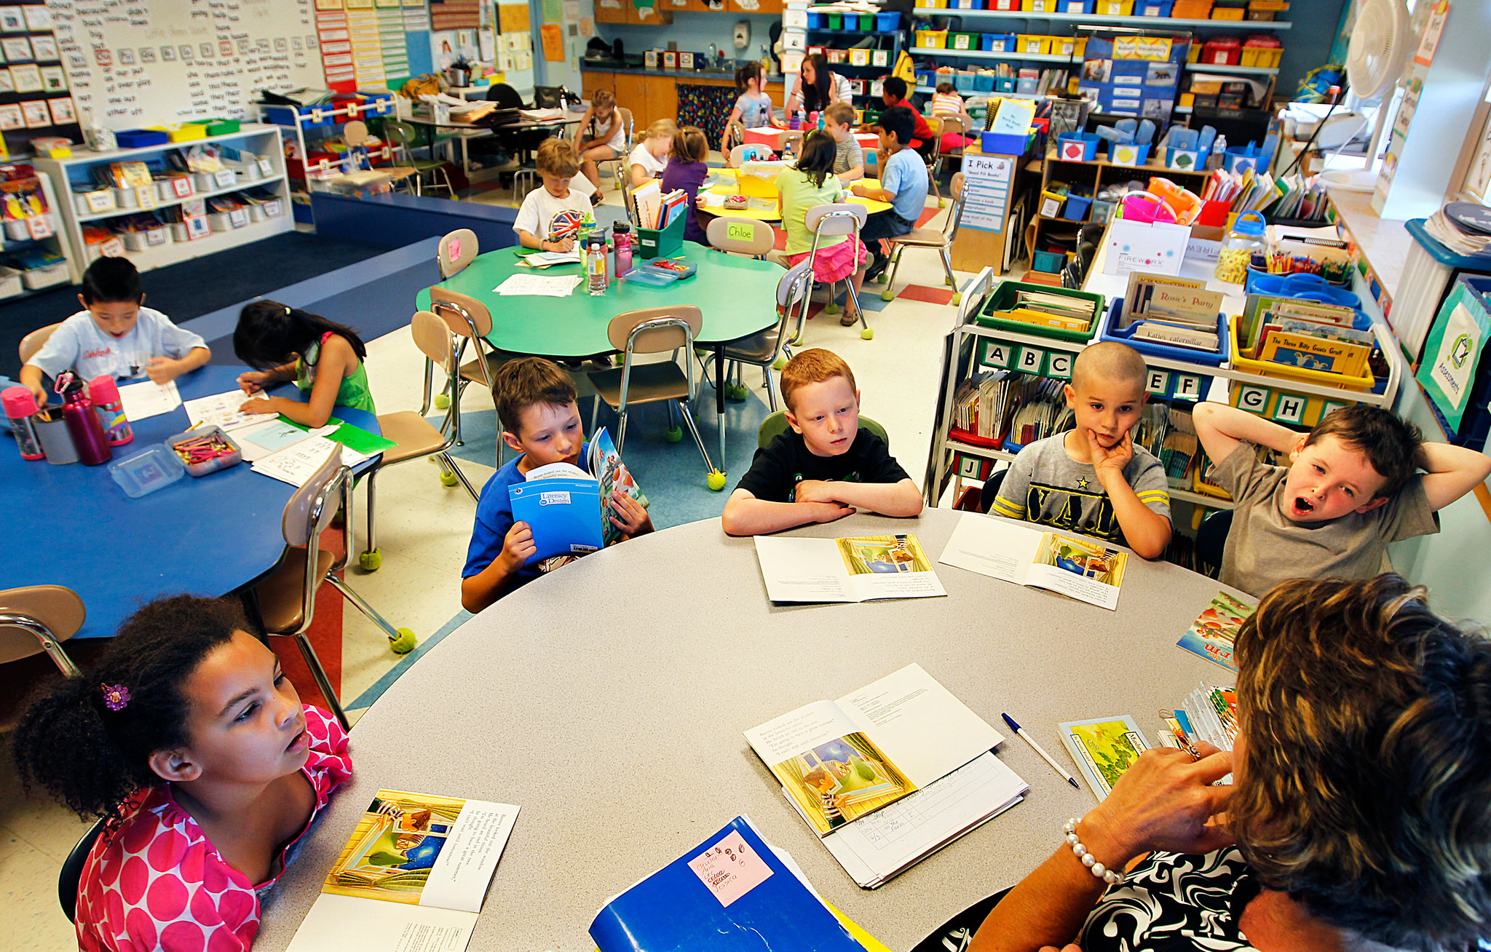
Weekly sessions!

Slide 8
Vibe check
FINDING TARGET…
FFWD
SYSTEM HALTED

Slide 9
Hands-on learning
Why join?
Interdisciplinary
Better than your course can give you
PLAY
Coding, 3d print/design, circuit making, sailing, physics, Linux, soldering, boat rigging, open source, integration, naval architecture, mechanical engineering, oceanography…
VIDEO LOADING

Slide 10
Team working
Self learning
PLAY
Soft skilzz
Project management
Logistics
VIDEO LOADING
Fund raising

Slide 11
SOFTWARE

Slide 12

boatd
FFWD
Manager of the boat control system
Separation between the boat decisions and the lower level hardware actions
Centralising components of a control system:
Share behaviours (logging, telemetry and behaviour management)

Slide 13


Slide 14

boatd documentation

Slide 15
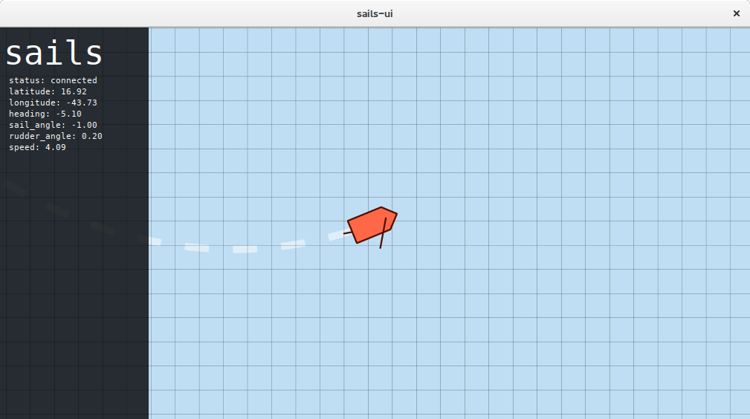
Simulation

Slide 16
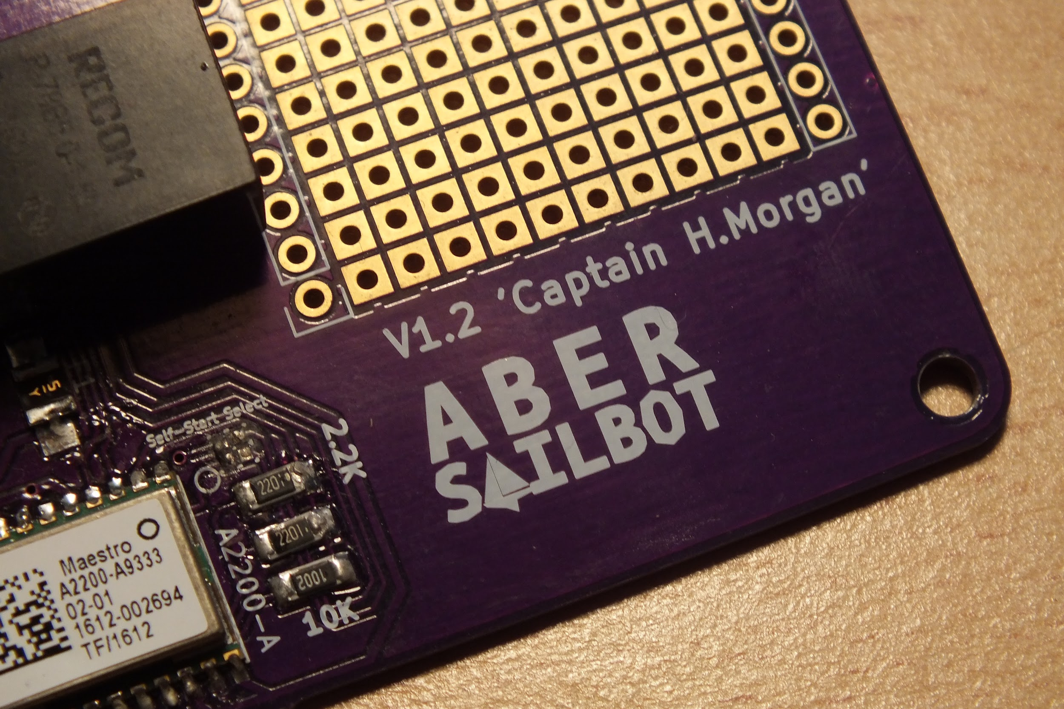
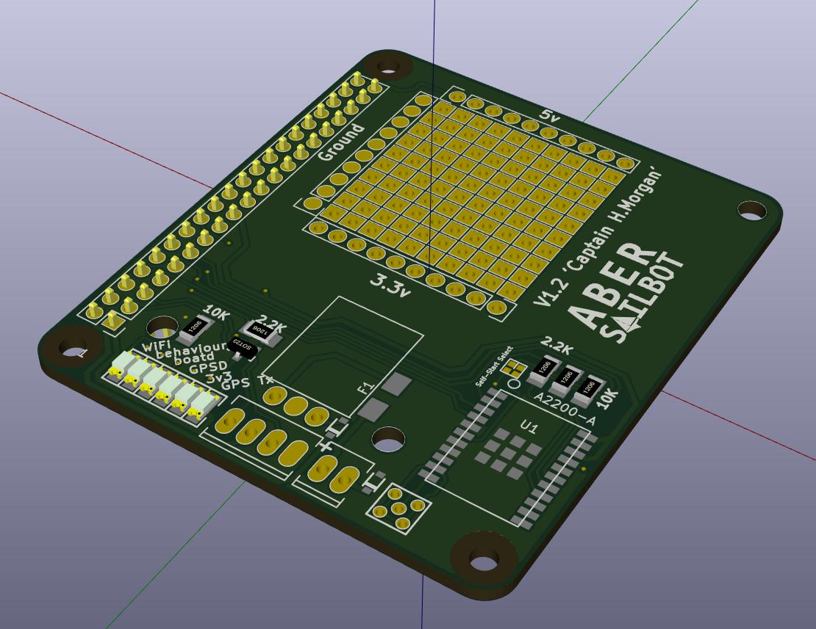
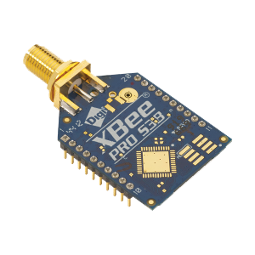
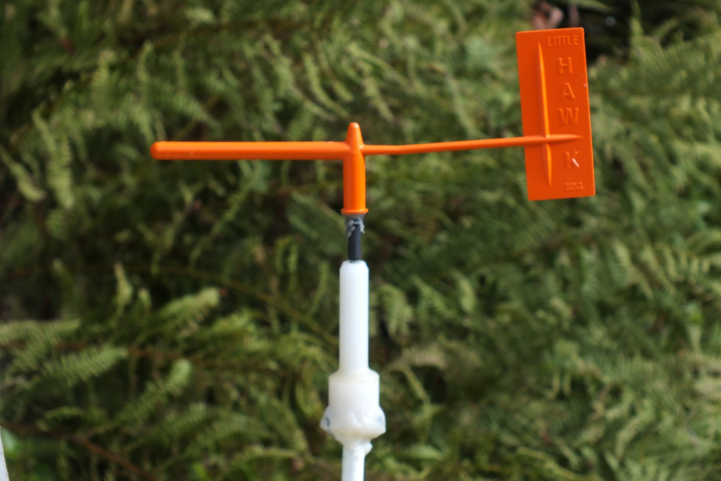
Electronics
RaspberryPi and Arduino
Captain Morgan PCB
Wind sensor
Compasss

Slide 17
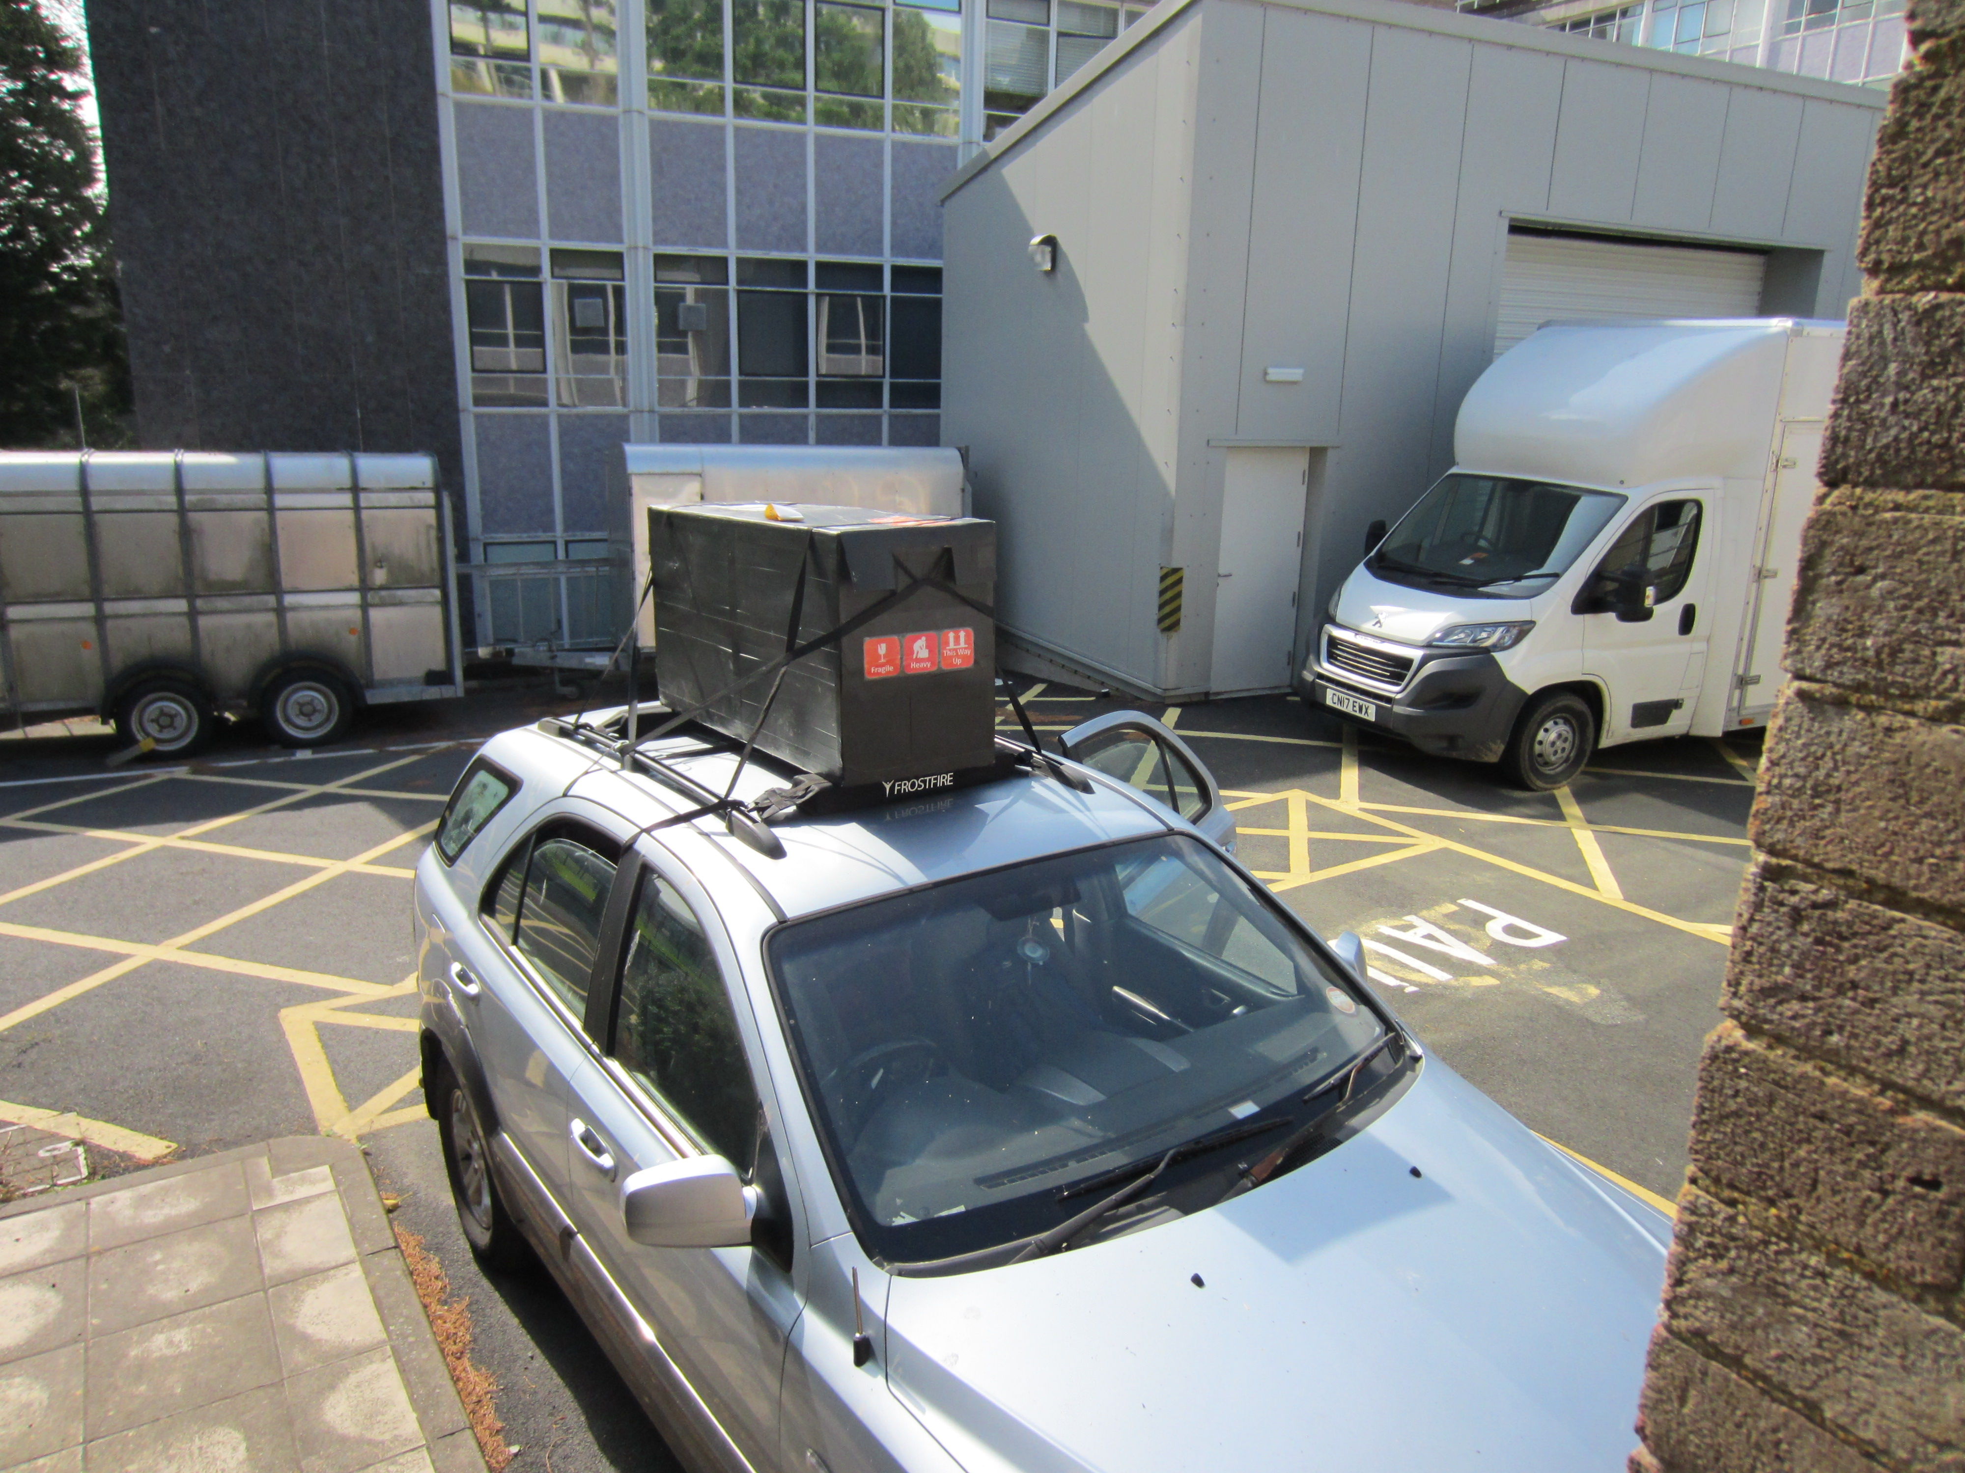
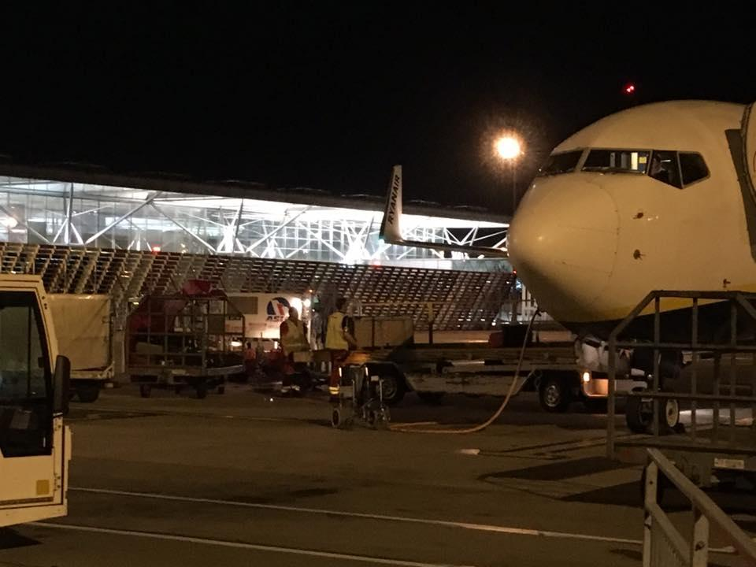
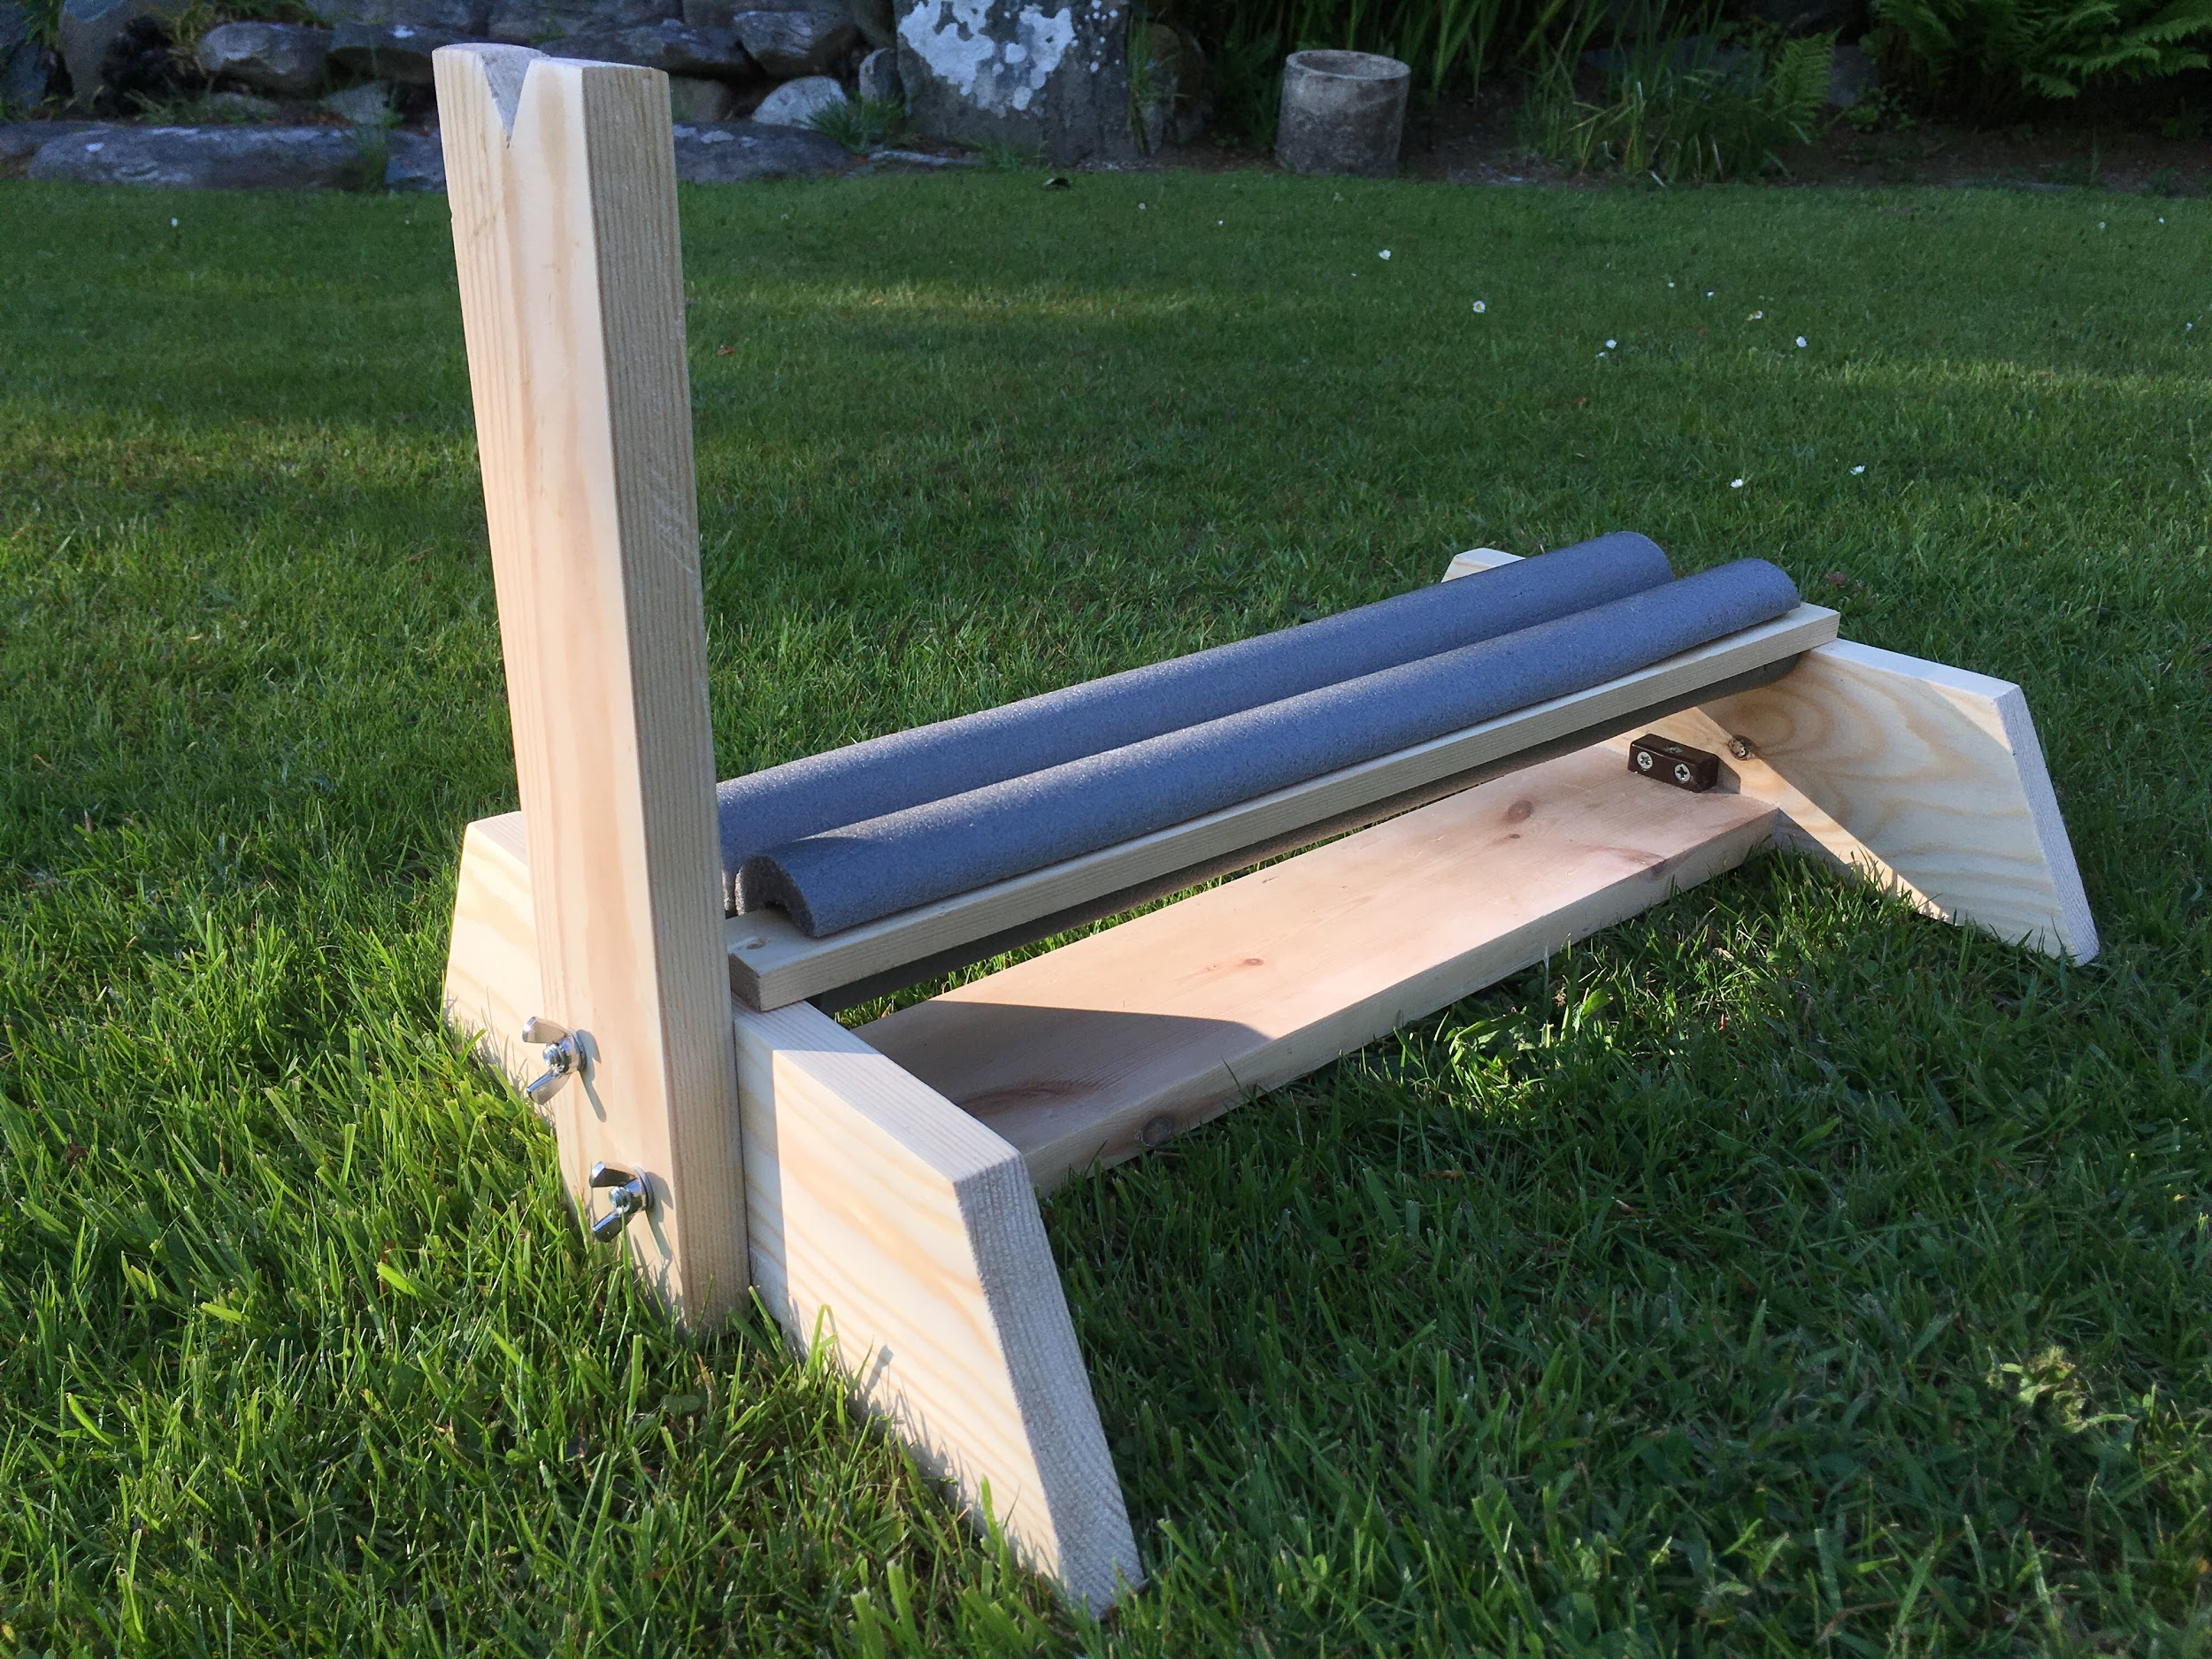
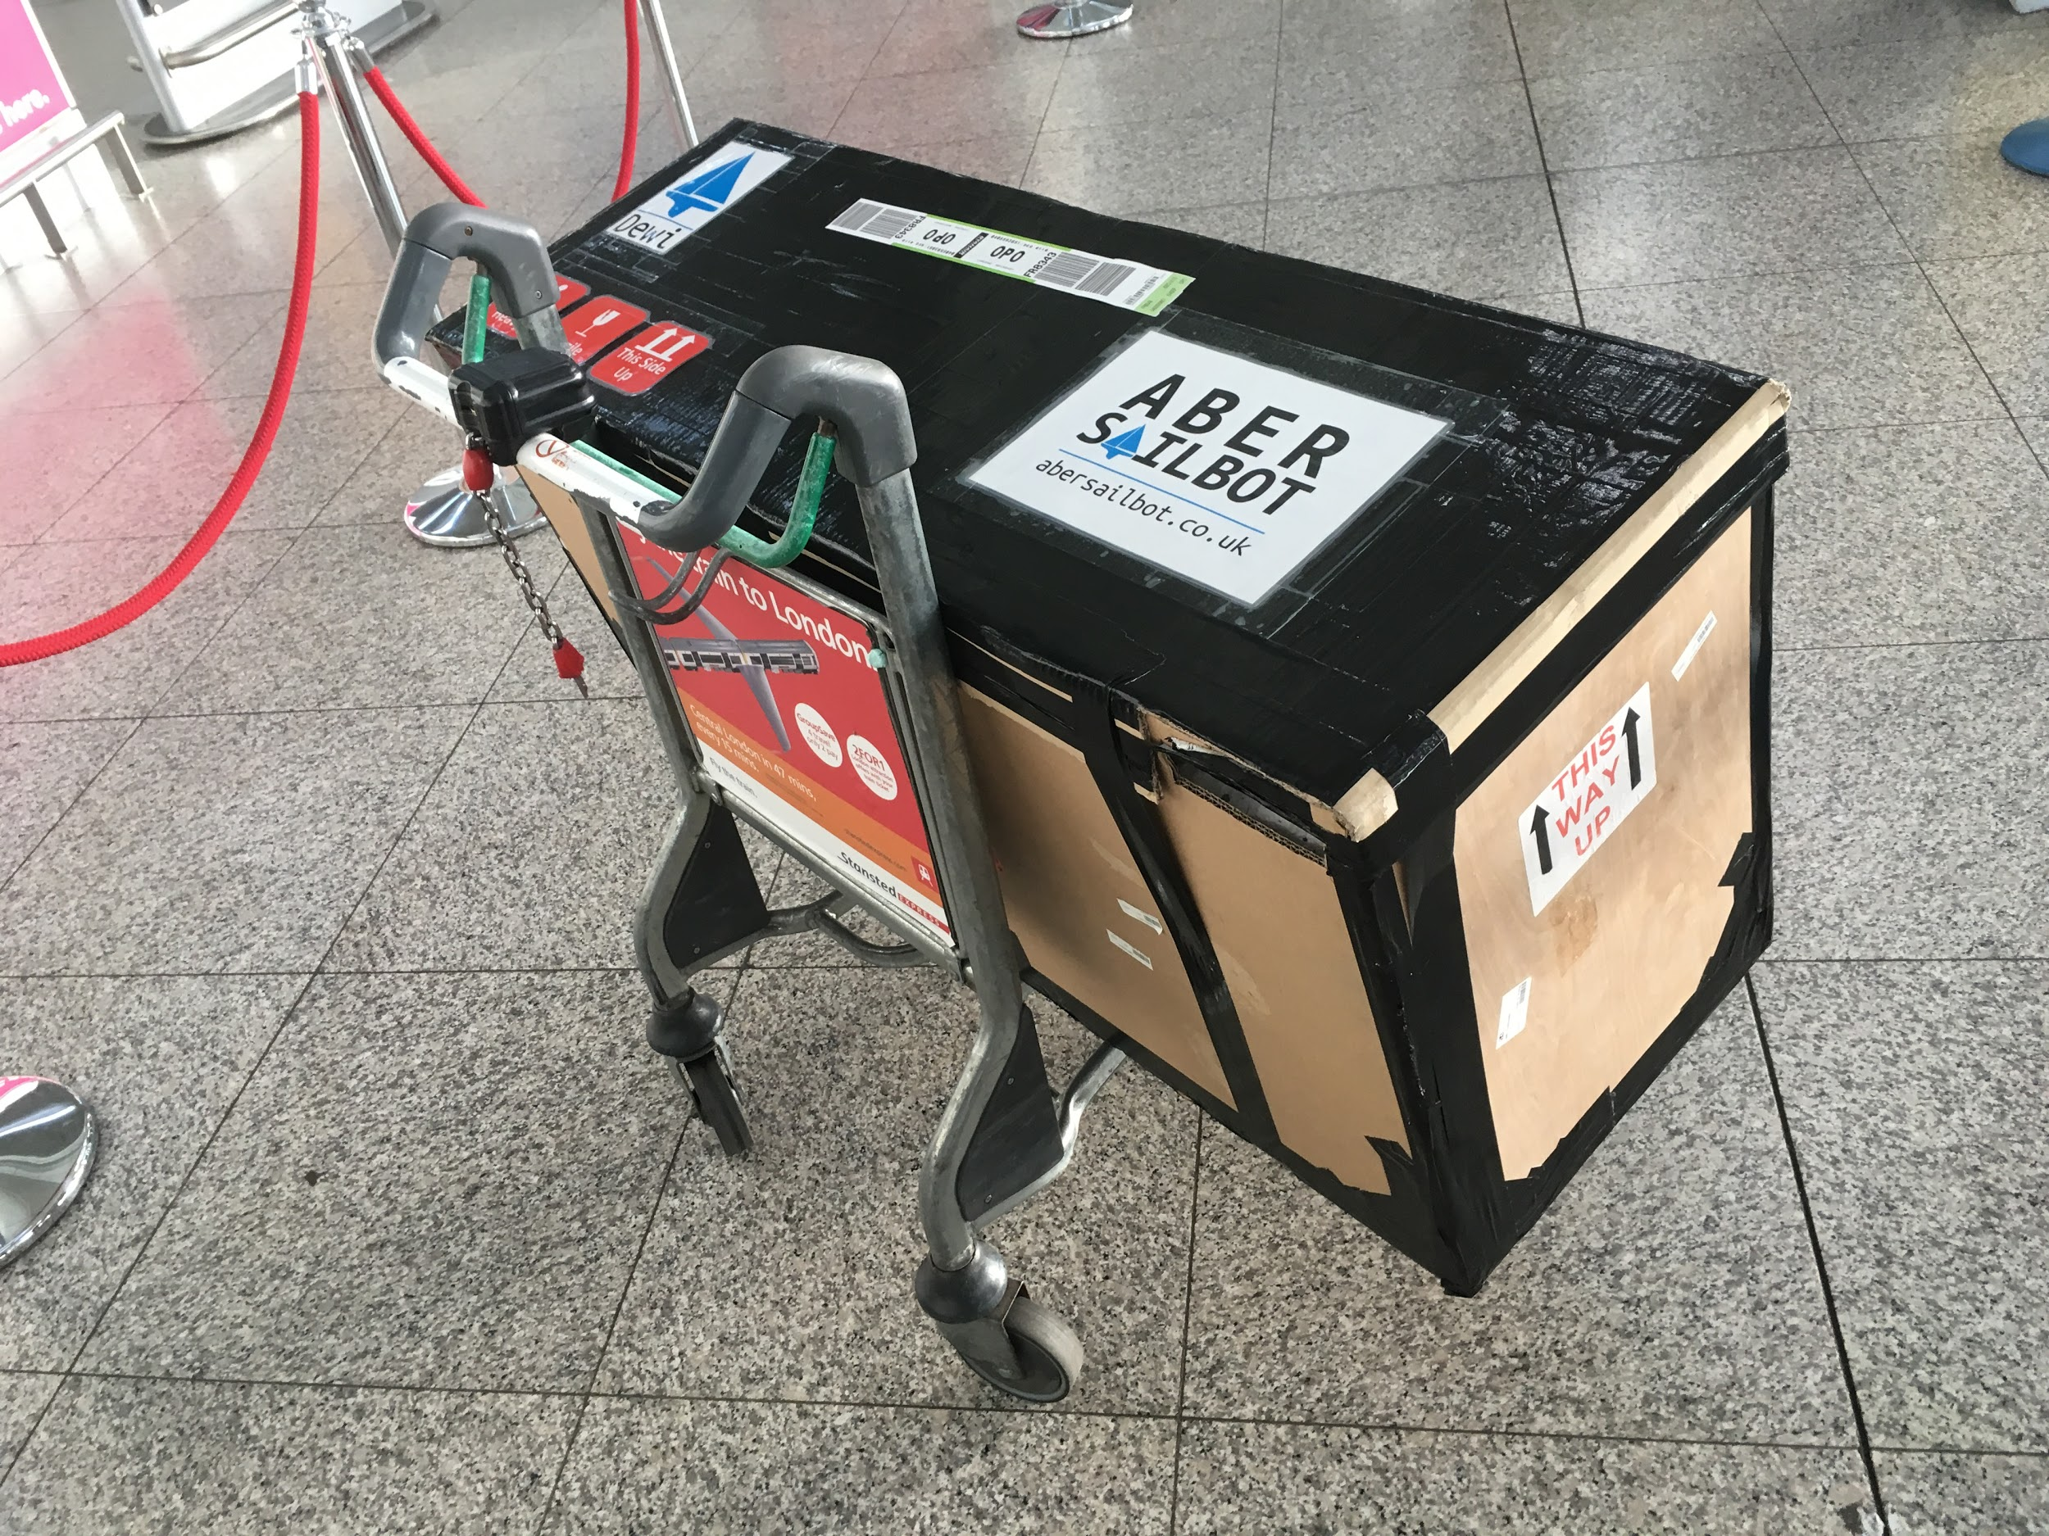
Transporation

Slide 18
Competitions
01
03
Sailbot
Student focused
Emphasis on boat design
Usually in USA or Canada
02

Slide 19
Competitions
01
World Robotic Sailing Championships
Research focused
Emphasis on autonomy
Collision avoidance
Station keeping
Are scanning
02

Slide 20
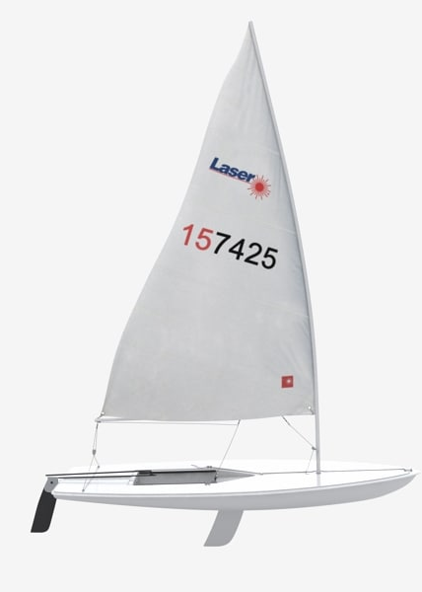
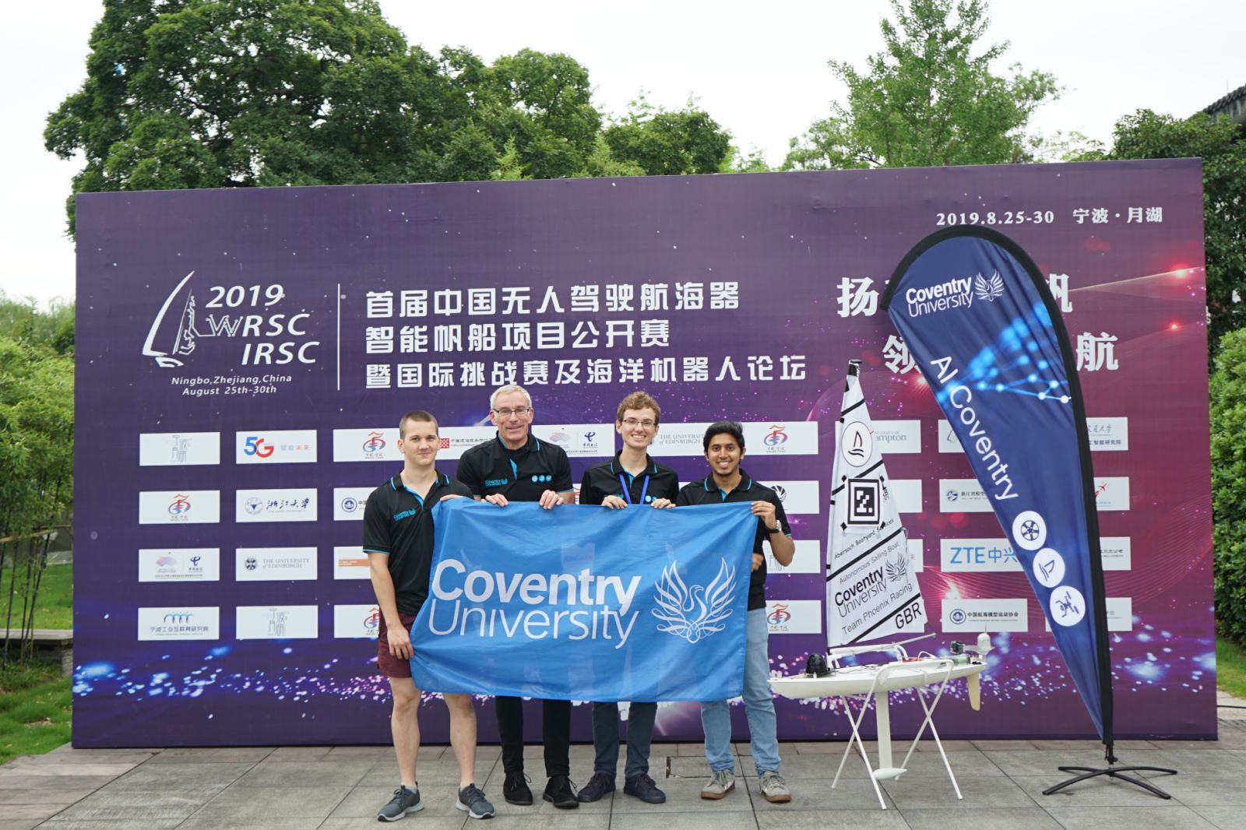
Competitions
01
03
Robosail
RC laser hulls
Everyone uses same boat
Joint Coventry-Aber
02

Slide 21
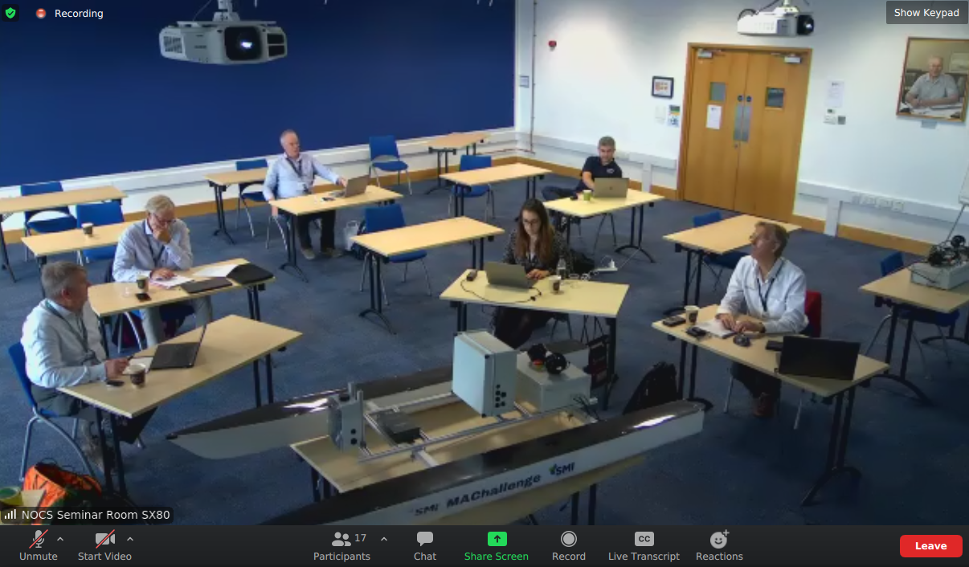
Competitions
01
[your computer desk image]
Marine Autonomy Challenge
03
Motorboat competition
Sponsored by industry (great for IY opps)
Locate “litter” in the water
Remote access to the boat
We have 4 days to apply ☺ (£2000 prize)
02

Slide 22
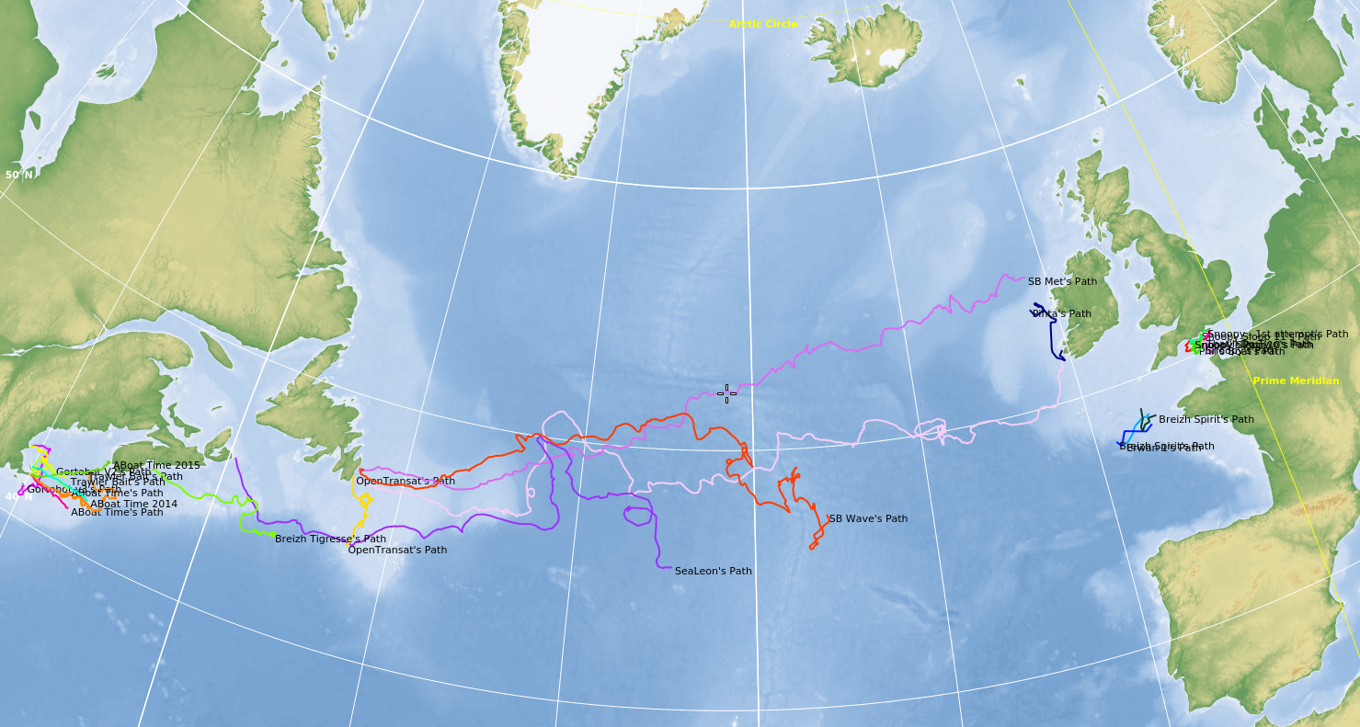
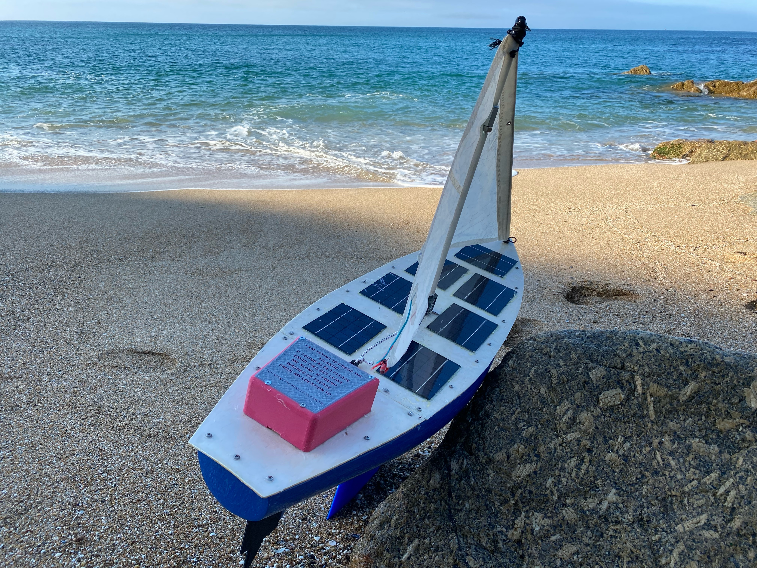
Competitions
01
Microtransat Challenge
03
Transatlantic sailing robot race
Running since 2010
Over 30 attempts
1 success, 1 in progress
AberSailbot yet to complete
02

Slide 23
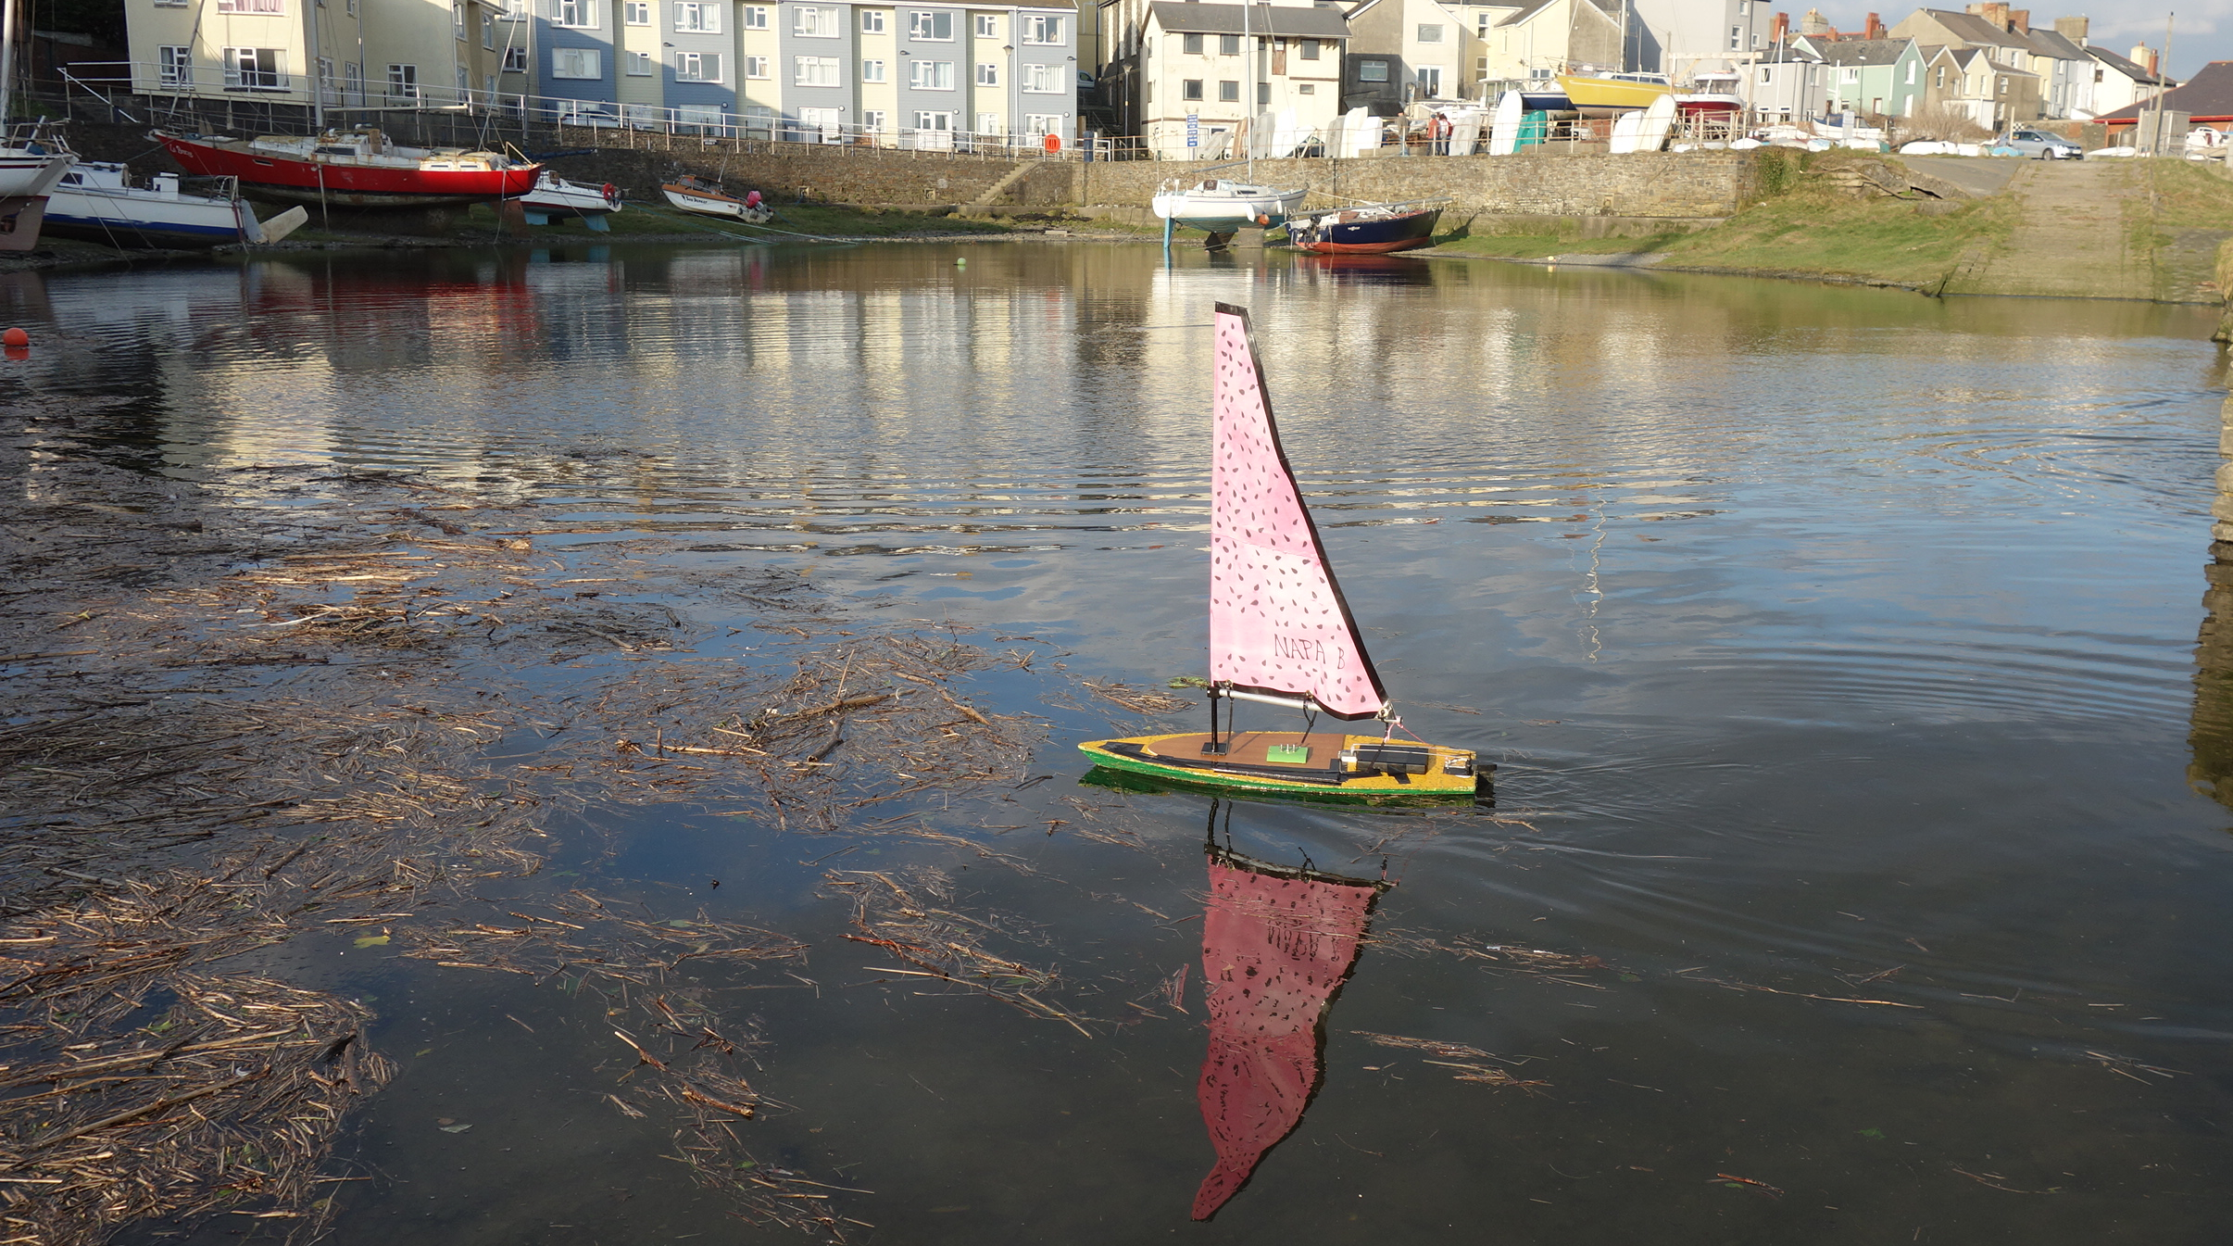
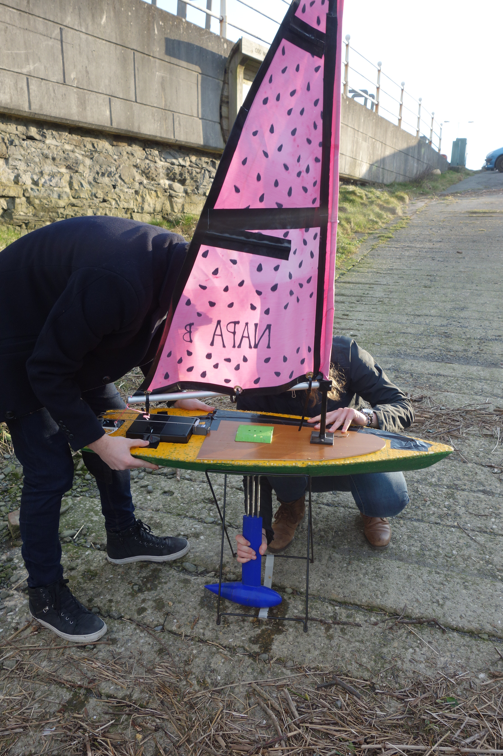
Competitions
The Great Aberystwyth Boat Off
01
03
3 boats
Teams of ?
Polystyrene RC laser hull
Raspberry Pi computer
Standard abersailbot software
02

Slide 24
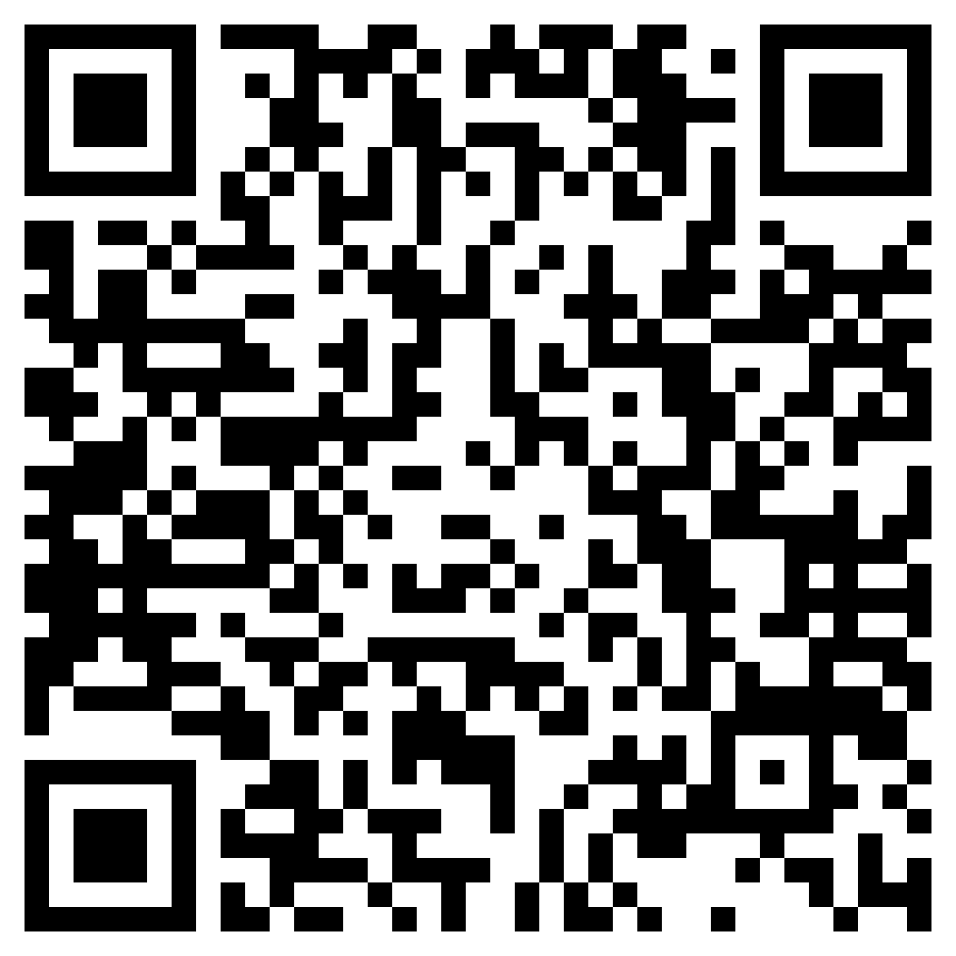
Sign up link
abersailbot.co.uk/joinus

Slide 25

Discord channel

Slide 26
Thank you!
Does anyone have any questions?
PLAY
FFWD
RWD

